Slide 1

DRIPPY
shen hongyi // yeoh lik hern
“Water is the driving force of all nature.”
~Leonardo da Vinci

Slide 2
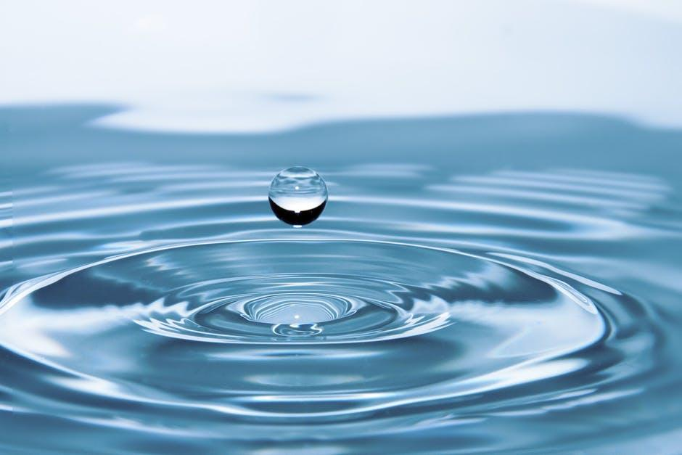
water

Slide 3

or not ?

Slide 4
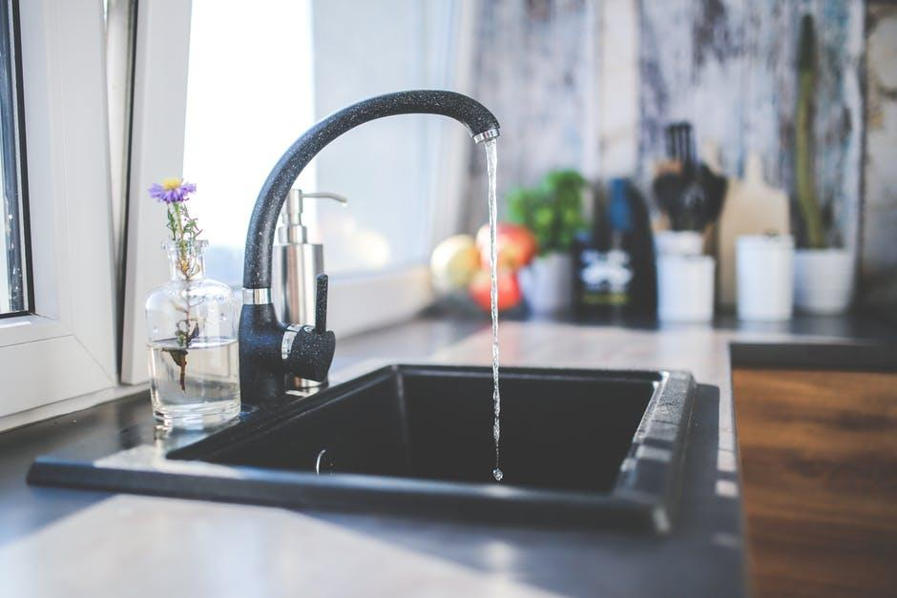

Slide 6
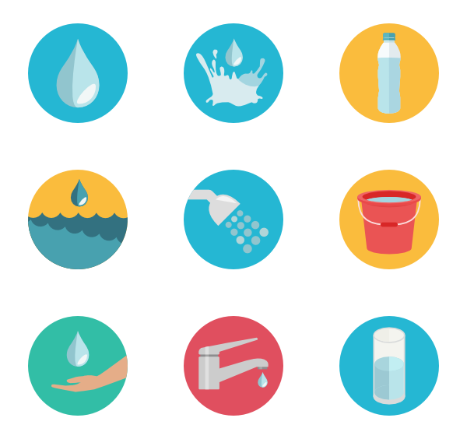
2 x
85%
20 L per person
of water usage is expected to increase
of water demand which the government is confident meeting
water usage that needs to be reduced
Source: TODAY Online; Public Utilities Board

Slide 7


Slide 9
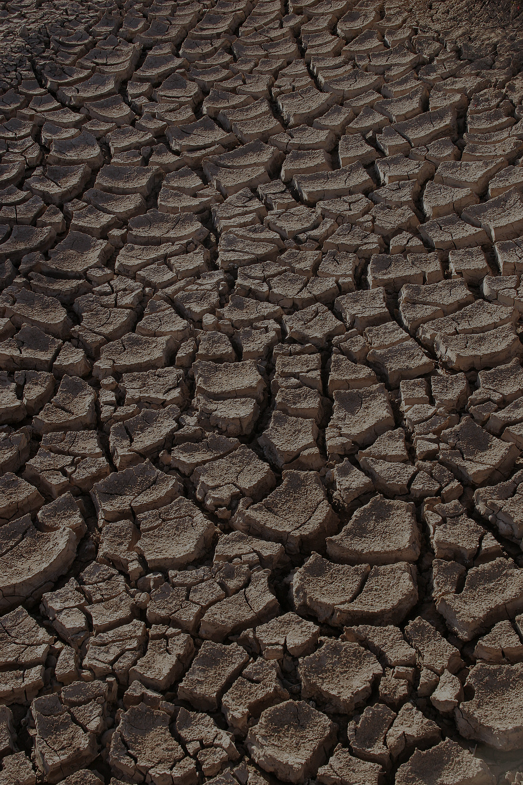

Slide 10

competitor
Notes:
Recently, PUB launched the WaterGoWhere app to allow households to track their water consumption on their phones. However, it has some shortcomings.

Slide 11
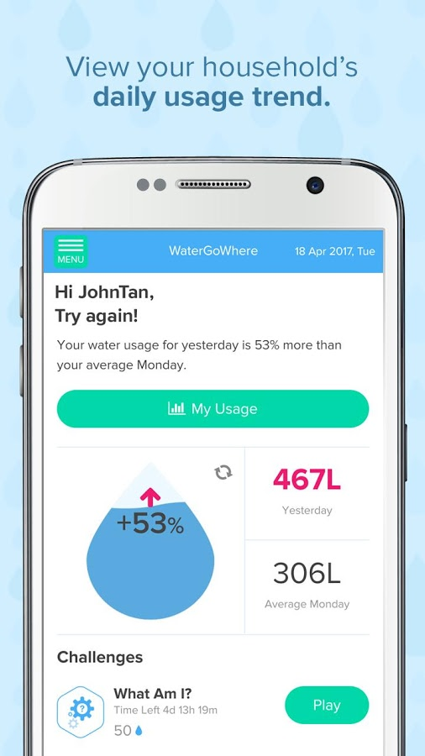
competitor
But why?
Notes:
One of its features is for people to track leaks, but it does not tell them where the leak is, and they have to search the whole house.

Slide 12
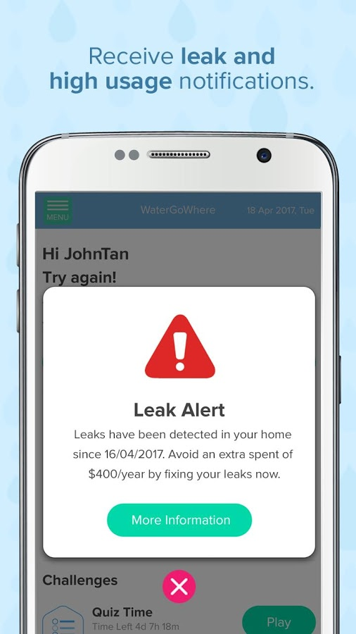
competitor
But where?
Notes:
One of its features is for people to track leaks, but it does not tell them where the leak is, and they have to search the whole house.

Slide 13
introducing
DRIPPY
app + water flow sensor

Slide 14
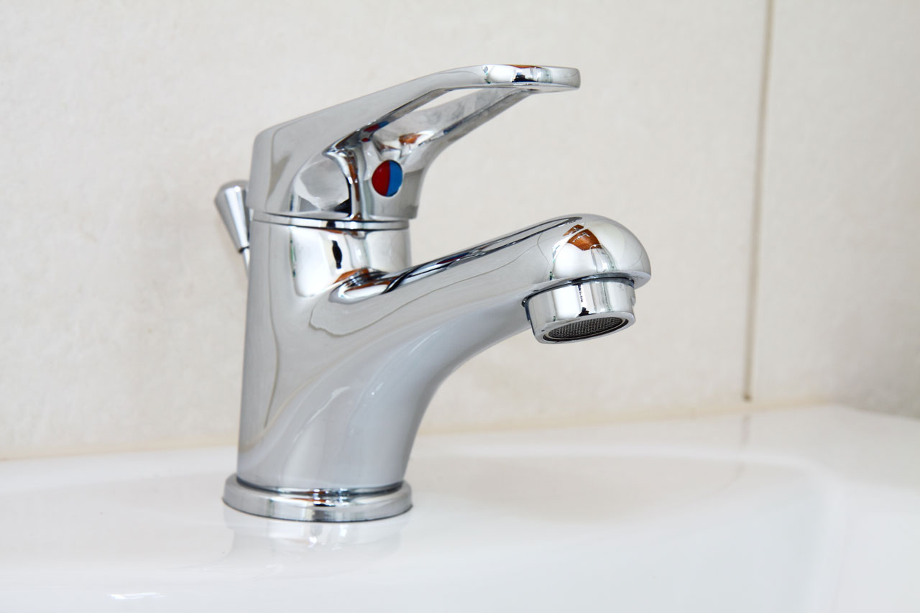

Slide 15
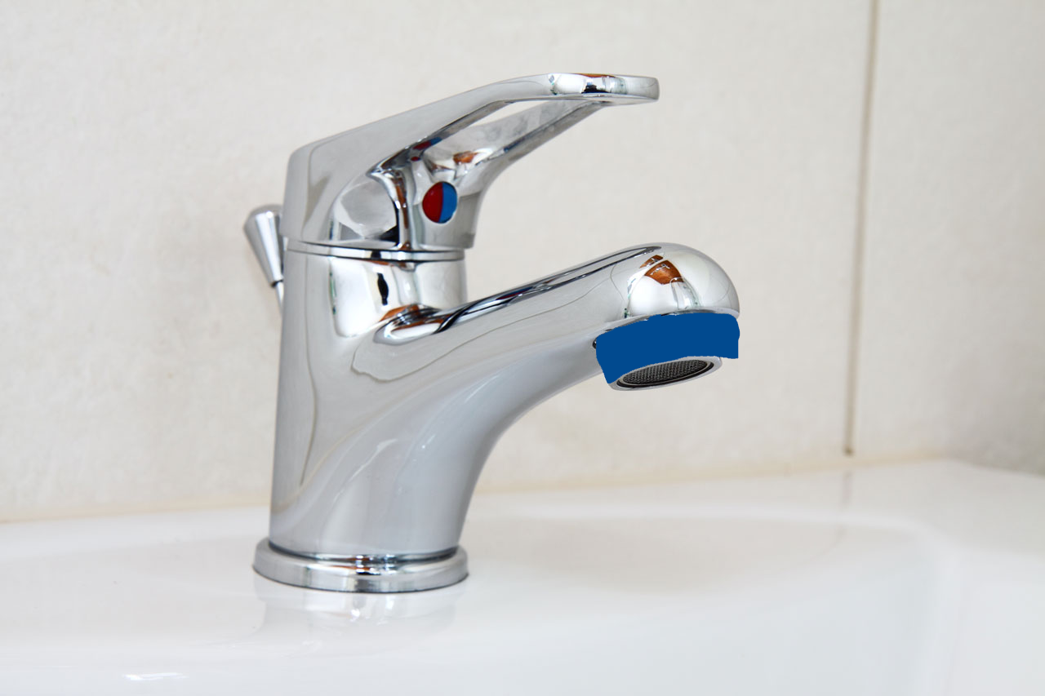
Notes:
Meter mechanics: ultrasound fired into pipe, refracted by water flow and reflected by bubbles, return analysed to give flow rate

Slide 16
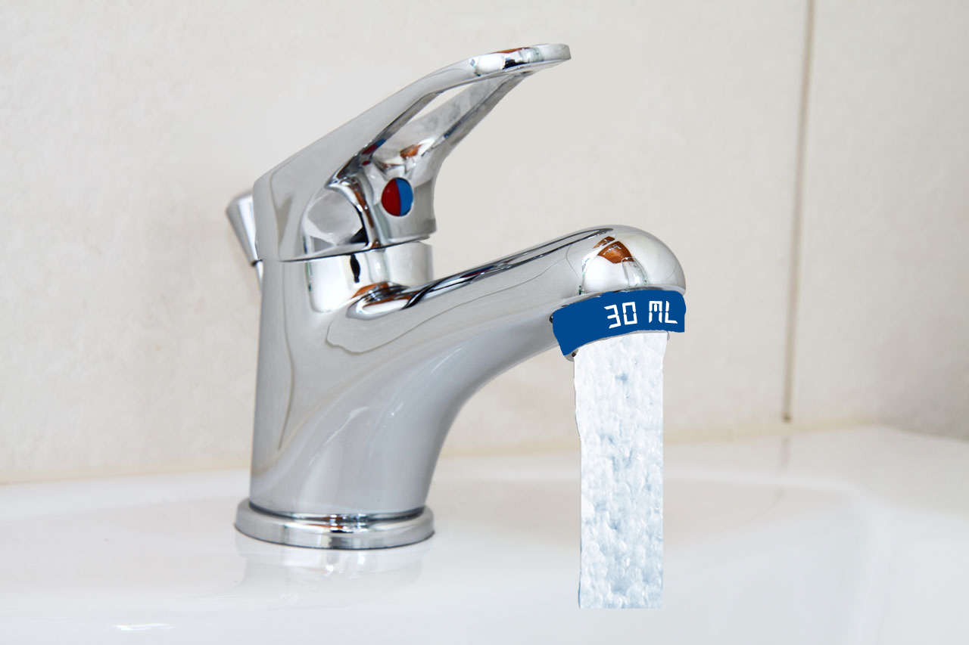

Slide 17


Slide 18


Slide 20
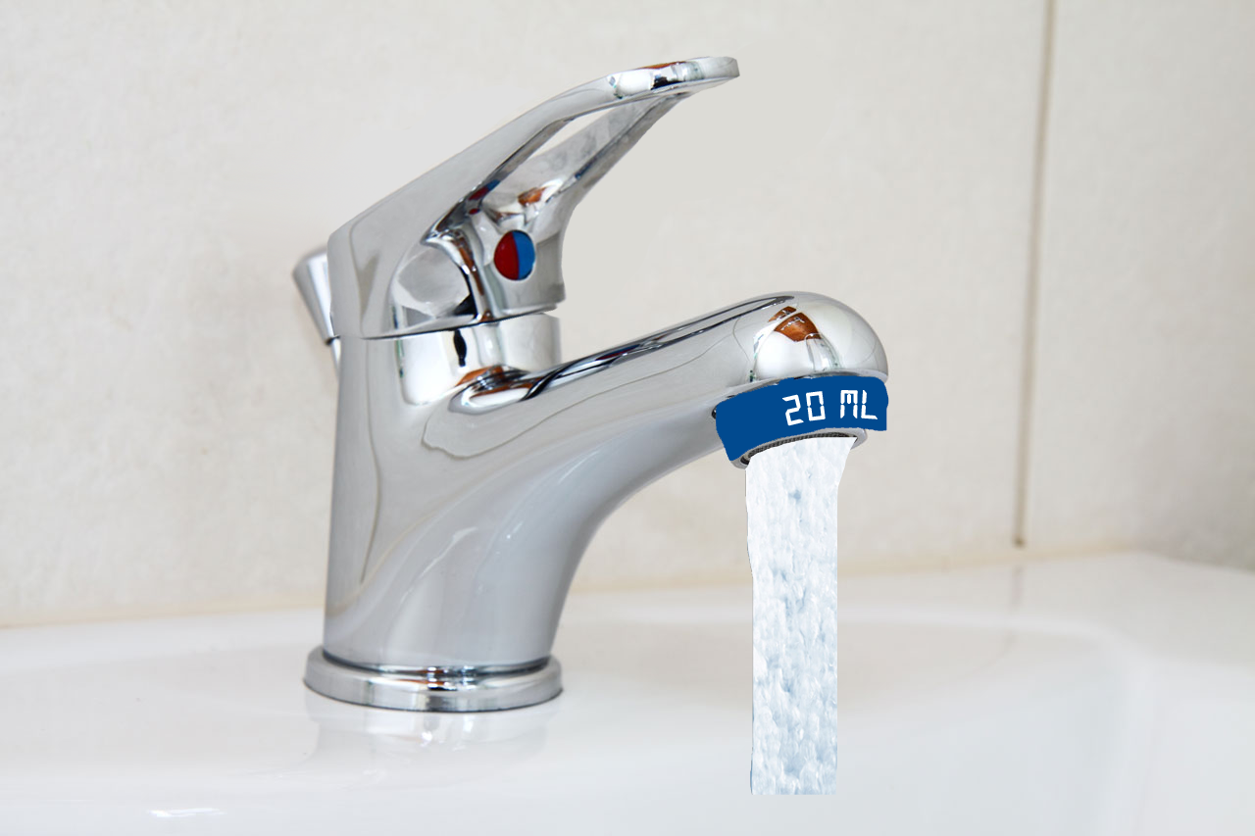

Slide 21


Slide 22


Slide 24
Meter Mechanics
Ultrasound fired into pipe
Refracted by water flow
Reflected by bubbles
Returned sound analysed to give flow rate
Source: Pulsar Process Measurement Ltd

Slide 25

app demo
DRIPPY
Notes:
https://yeohlikhern.proto.io/player/index.cfm?id=a505e3dc-0d80-4d93-8b02-c6e641e3fede

Slide 26

Why we are cool
Empower individuals
Immediate feedback on water usage
Track water consumption of each appliance
Targeted and localised leak detection

Slide 27

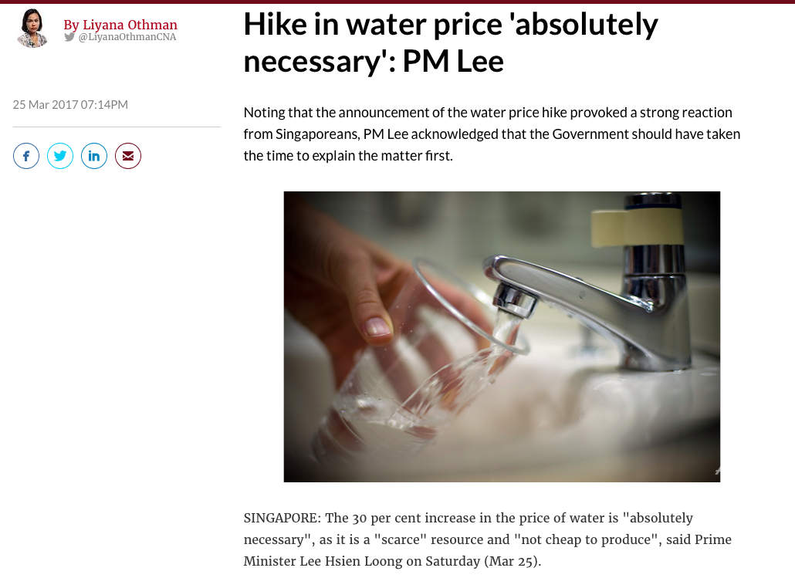
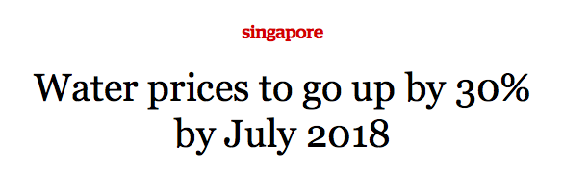
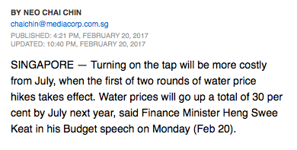
Households

Slide 28
3,000 GALLONS
A tap that leaks at one drop per second will waste
per year
Whoa! That’s a big number.

Slide 29
THANK YOU!
Water you waiting for?

Slide 30
DRIPPY

